Slide 1
Manchester
Raspberry Jam 27
March 2015

Slide 2
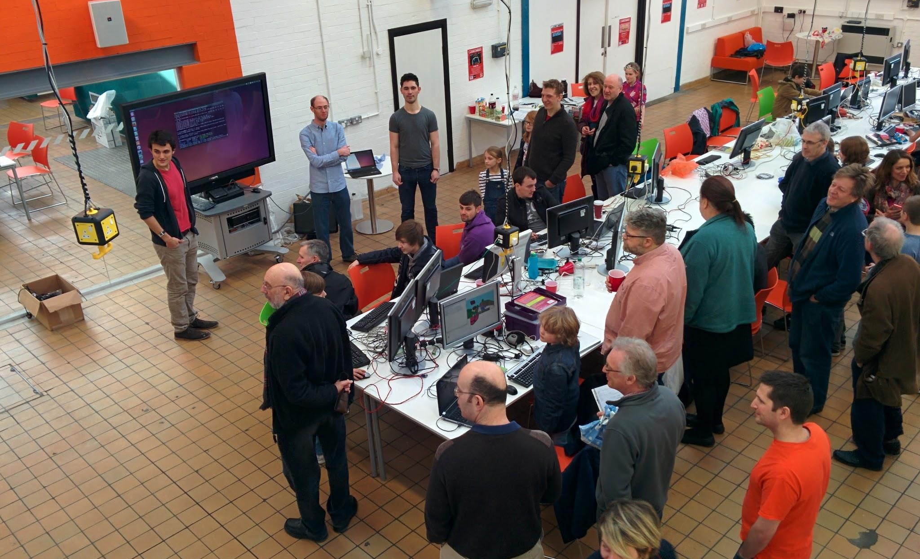
Last Time

Slide 3
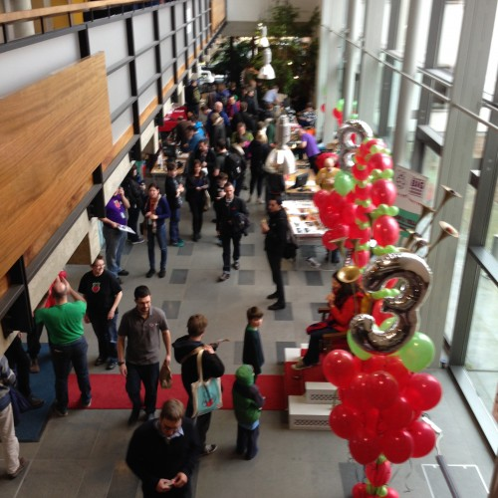
Raspberry Pi Big Birthday Bash

Slide 4
Today:
11:00 - Introduction to Minecraft
11:45 - Minecraft Workshop
13:30 - Pizza
15:00 - Circles in Minecraft Workshop
WiFi:
SSID MMU-Visitor
Pass. University
Next Month’s Jam: Saturday 7th March

Slide 5


Slide 6
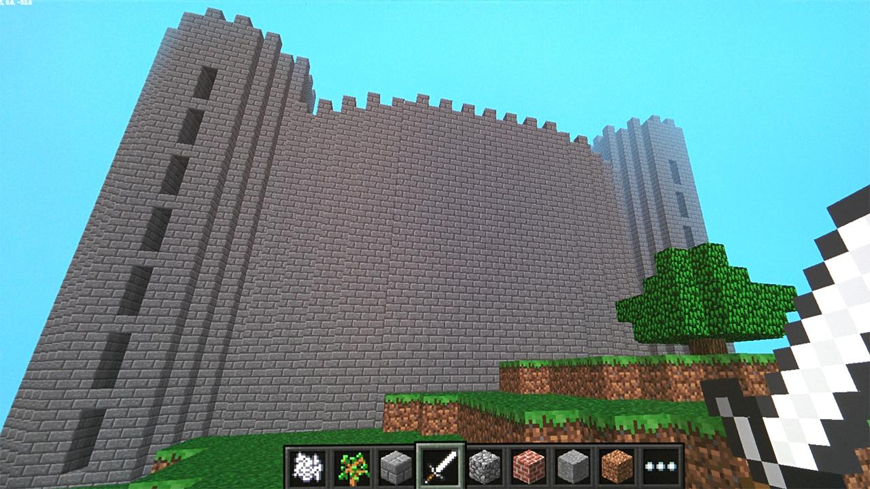

Slide 7
Next Month...
Manchester Raspberry Jam 26
Saturday 7th February

